Slide 1
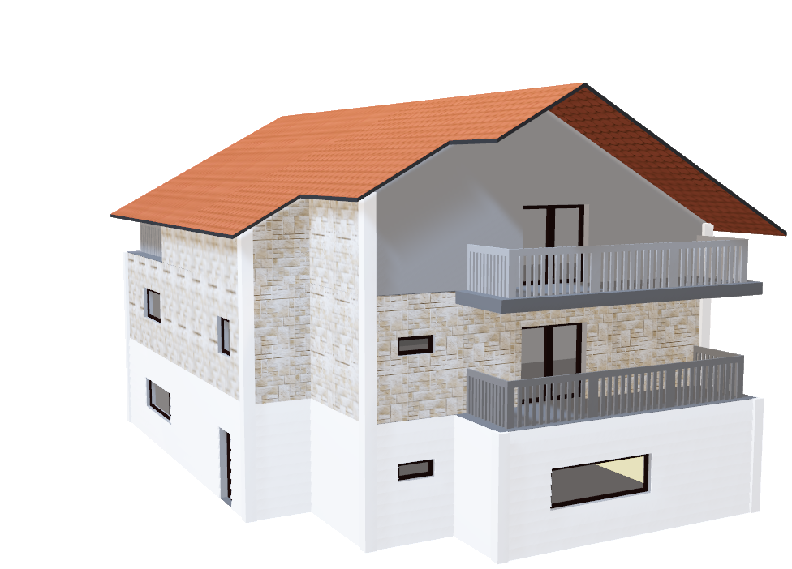
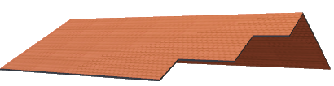
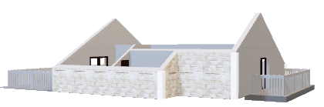
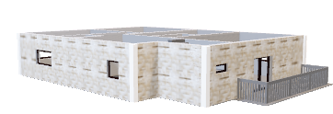
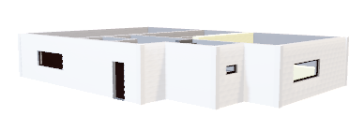
House Hunters Presents: The Ultimate in Modern Home Search
In a world where downtime is more wishful thinking than reality, it’s essential that your home offers true tranquility, space and comfort.
Introducing the Fit Analysis for living:
House Hunters Evaluation
Designed to help you make the most efficient use of your time while searching for your dream home. Whether it’s natural light, soaring ceilings, 8ft doors and enough space for you family; we’re here to make your dreams come true.

Slide 2
House Hunters
Thomas Clemons: Chairman and CEO
Gi’Anna Cheairs: CFO and Comptroller
Vineet Duggi: CTO
Timothy Carter: COO

Slide 3
Executive Summary
Goal: The aim of our project is to identify which attributes have the most impact on price and then predict the sale price of homes in Ames, IA.
We’ll examine relationships between various home attributes and the sale price.
We will use this modeling to predict the sale price of homes that we have in our Real Estate portfolio.
We identified an appropriate data file.
We analyzed data file attributes, cleaned, and transformed them for modeling.
We ran cleansed, transformed data file through a variety of regression models to determine best model for predicting sale prices.

Slide 4
Project Approach
Data File
Read in CSV
Reviewed Length
Reviewed Type
Data Preprocessing
Remove/Rename missing Values
Train, test, split
Categorical Variables - LabelEncoder
Numeric variables - StandardScaler
Variance Inflation Factor (VIF)
Probability Value (p-value)
Linear Regression, OLS
Regression Analysis
Lasso, Random Forest, Gradient Boost and CatBoost
Coefficient (R-Squared), Evaluate Mean Absolute Error (MAE) and Mean Squared Error (MSE)
Best Model and Validation
CatBoost

Slide 5

Data Collection, Cleanup, and Exploration
Reviewed Value_Counts for all variables
Dropped variables with high percentage of same values or null values
Transformed remaining null values based on analysis of home variables
Encoded categorical variables using LabelEncoder
Scaled numeric variables using StandardScaler
Performed VIF and P-Value analysis to identify any variables that should be removed (VIF > 10; p-value >= 0.05)
The home sales file was reduced from 81 to 24 variables

Slide 6
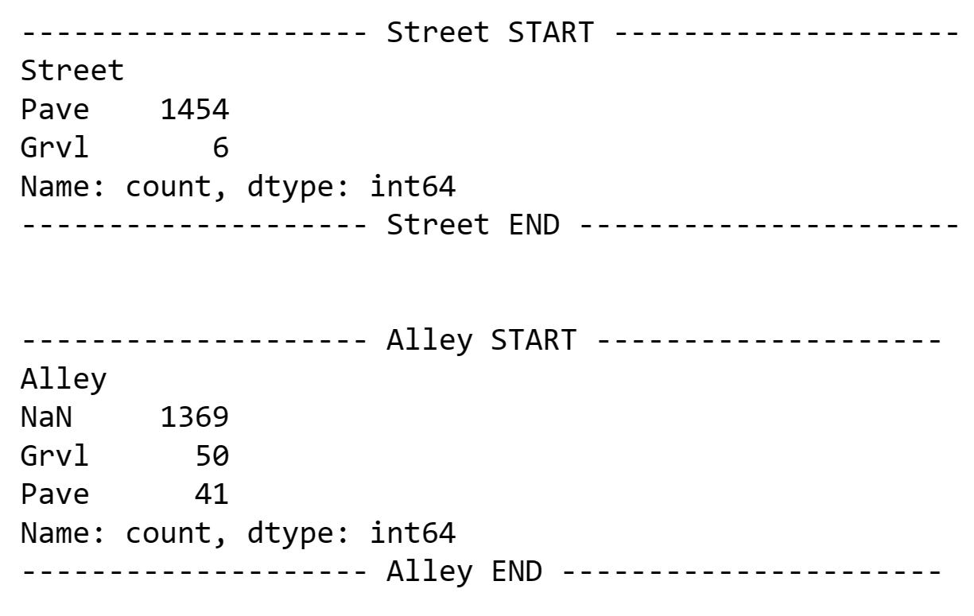
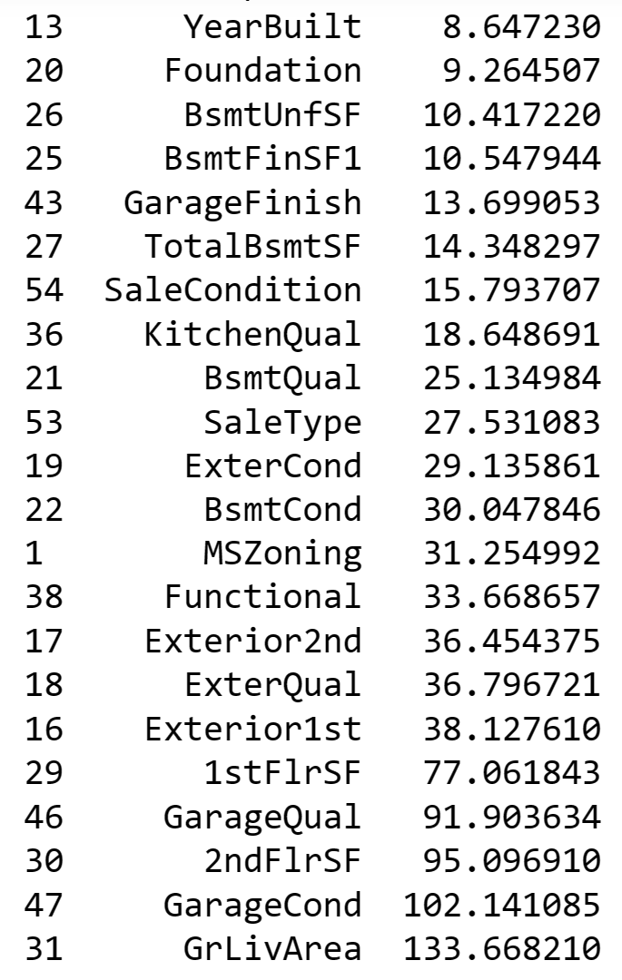
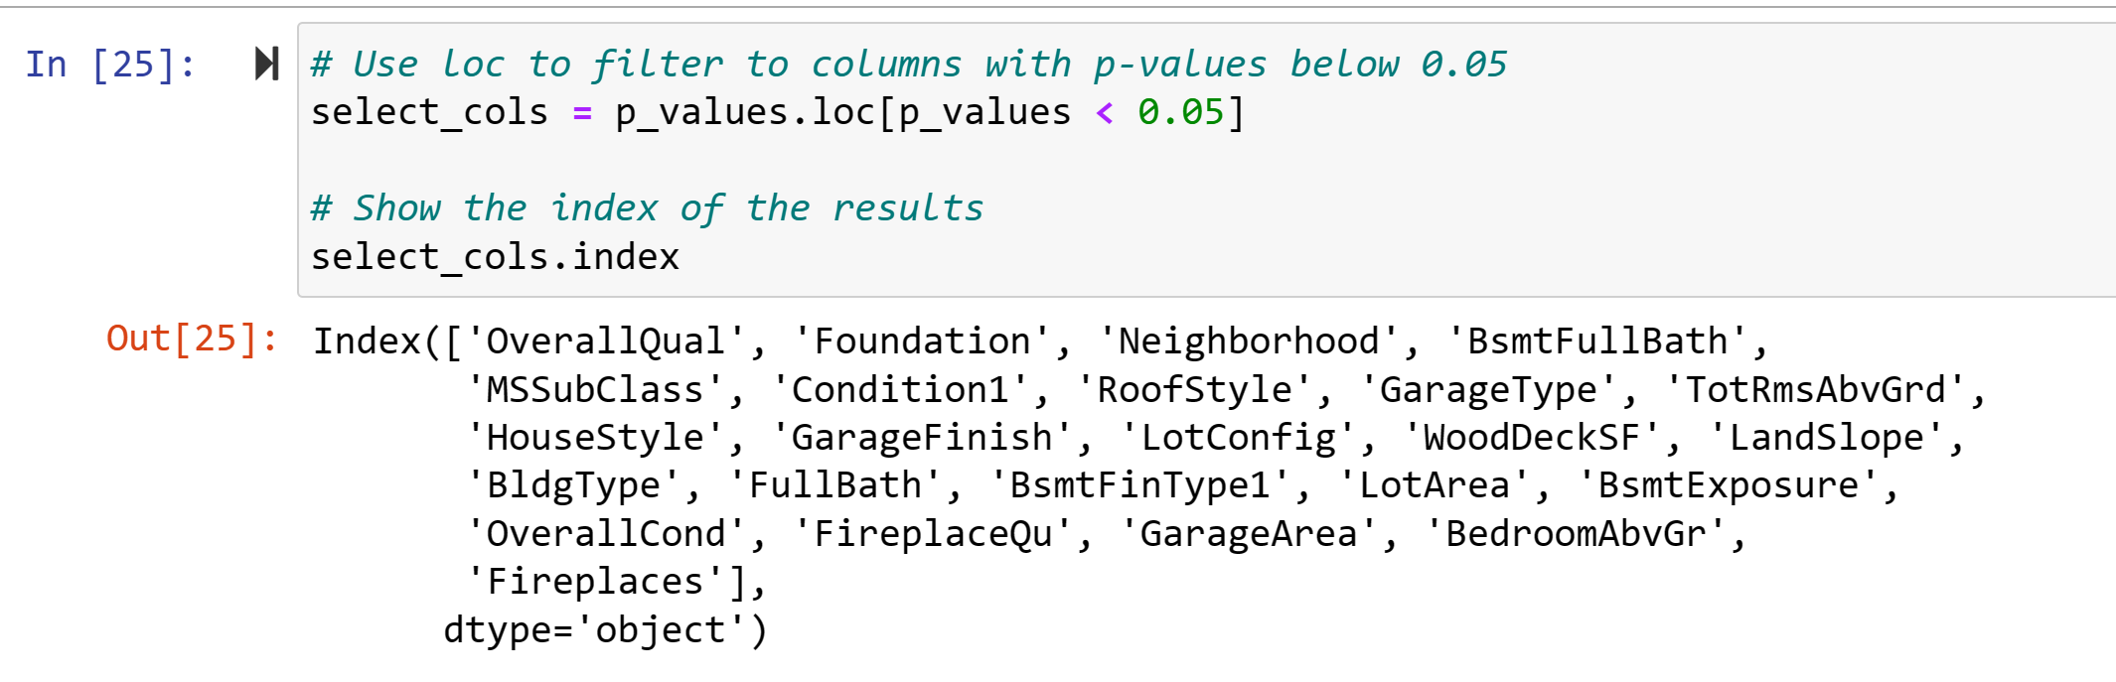
Data Collection, Cleanup, and Exploration - Examples
VIF
value_counts
p_values

Slide 7
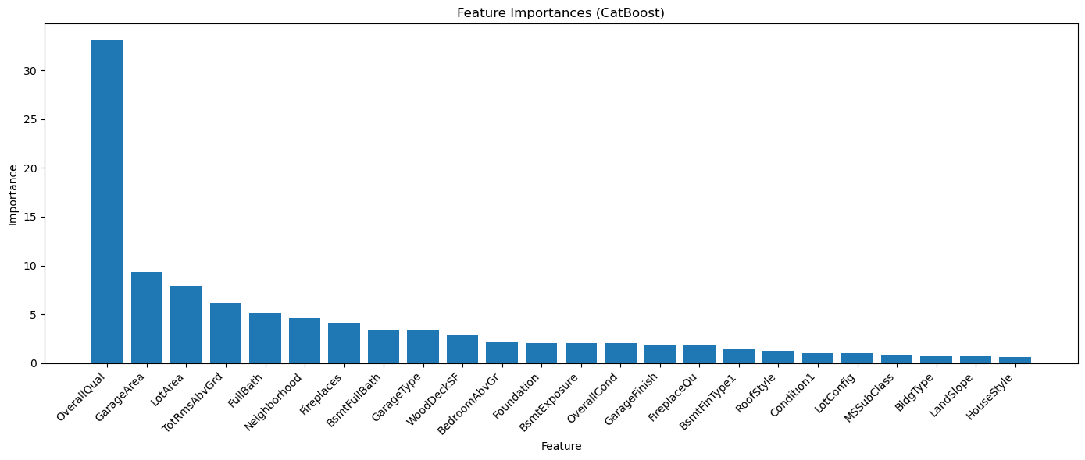
Price Impact - Features
Overall Quality, incorporating the latest technology of a home, is by far the most important feature for homebuyers.
Garage Space has also played an integral role for many.
One must not forget about Lot Area and Total Rooms.
Expansive Full Baths most certainly has its place on the list.

Slide 8
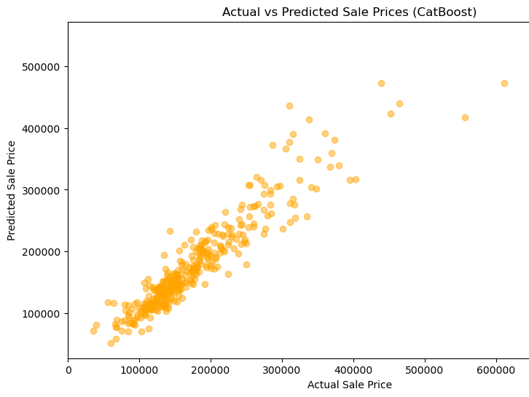
Sales price prediction model CatBoost
Values Narrative
R-squared: 0.8774344325281175
Mean Absolute Error:
19291.19610825505
Mean Squared Error:
858609679.3158845
Root Mean Squared Error:
29302.04223797182

Slide 9
Conclusion
Lasso R-Squared - 0.7830943994223807
CatBoost in our data file provided the most accurate model.
Lasso as you can see did not meet or fulfill the project requirements.
We wanted to view several models to determine the best fit.
Random R-Squared - 0.8536607463238572
XGBoost R-Squared - 0.8553621589835805
CatBoost R-Squared - 0.8774344325281175

Slide 10
Additional Questions…
Tune model to take better advantage of optimal home selling season.
Refactor notebooks for pipeline processing.
Bring in Real Estate SME to verify model predictions.
Further dive into the statistical aspects of this model, (e.g. t-statistic).

Slide 11
APPENDIX

Slide 12
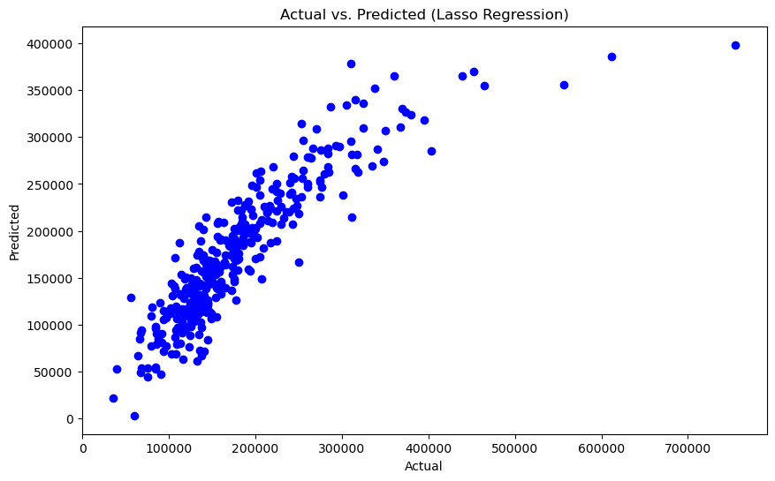
Lasso
The Values Narrative
R-squared: 0.7830943994223807
Mean Absolute Error:
25173.89159828941
Mean Squared Error:
1519490767.2294931
Root Mean Squared Error: 38980.64605967291

Slide 13
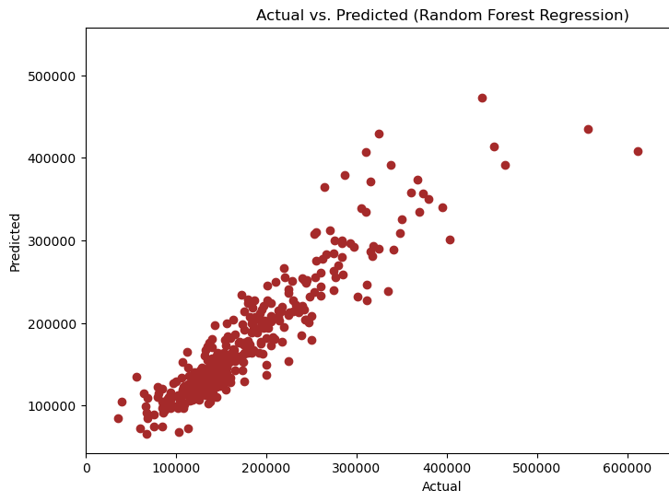
Random Forest
The Values Narrative
R-squared: 0.8536607463238572
Mean Absolute Error:
20753.749406392697
Mean Squared Error:
1025151698.4900634
Root Mean Squared Error: 32017.990231900305

Slide 14
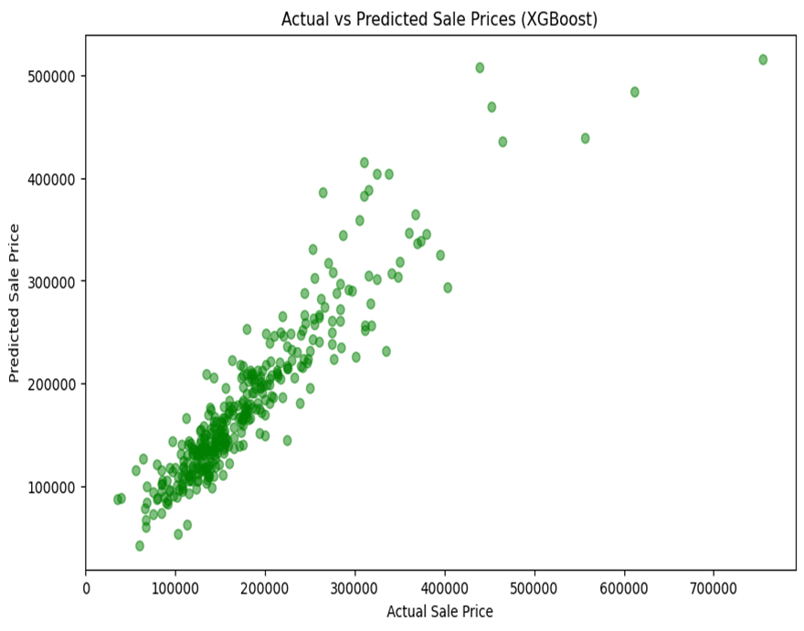
XGBoost
Values Narrative
R-squared: 0.8553621589835805
Mean Absolute Error:
21126.00980308219
Mean Squared Error:
1013232776.9831389
Root Mean Squared Error:
31831.317550223066

